Slide 1

SMART INDIA HACKATHON 2022
TEAM NAME: DELGOBAS
TEAM ID: 32910
IDEA ID: 31935

Slide 2
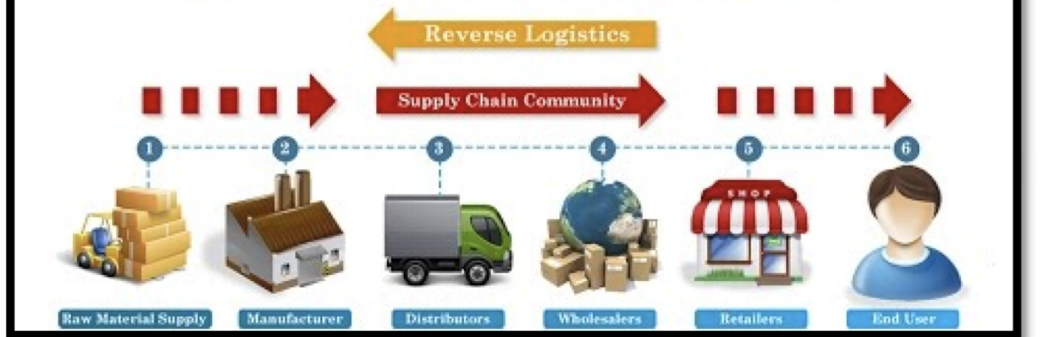
PROBLEM ID: LC1074
ORGANIZATION: Ministry of External Affairs (MEA)
PROBLEM STATEMENT: Use of technology in trade and logistics in reducing
transportation and transaction costs.

Slide 3
TEAM MEMBERS
ROLL NO | NAME
19Z224 | Lohith Sowmiyan P S
19Z210 | Deepti Ravi Kumar
19Z237 | Balasubramanian S
19Z238 | Sairam Vaidya M
19Z247 | Srivathssan V V
19I231 | Guna M

Slide 4
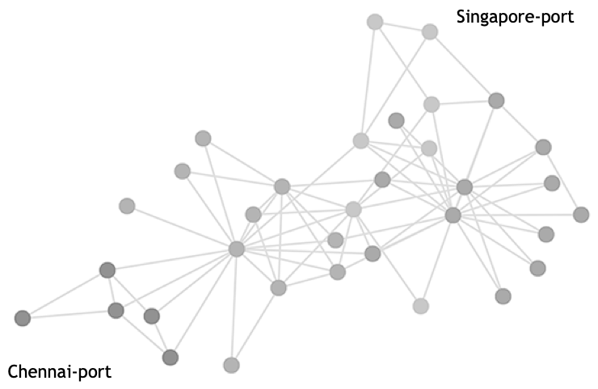
PROJECT OBJECTIVE
To reduce the overall shipment costs of goods travelling from Destination A to Destination B

Slide 5
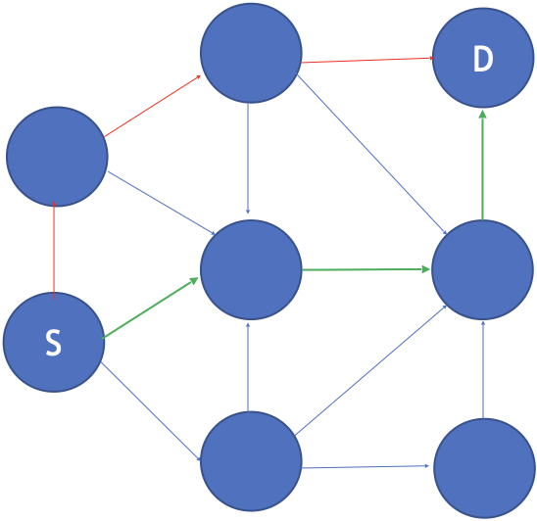
PROJECT APPROACH
Distance
Freight Cost
Documentation Cost
Customs
Bunker Cost
Transit Time

Slide 6
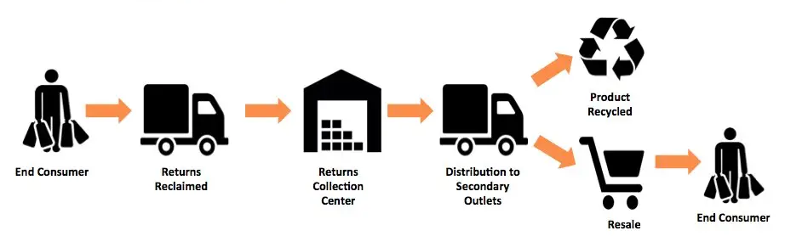
PROJECT APPROACH
REVERSE LOGISTICS
Product demands in various locations will be forecasted before shipping

Slide 7
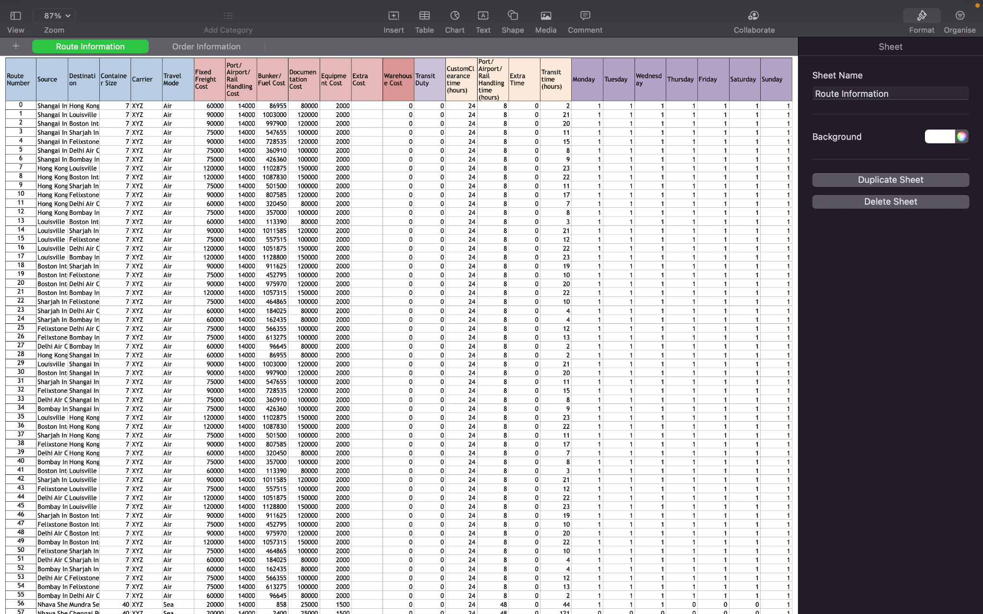
DATASET
ROUTING INFORMATION

Slide 8
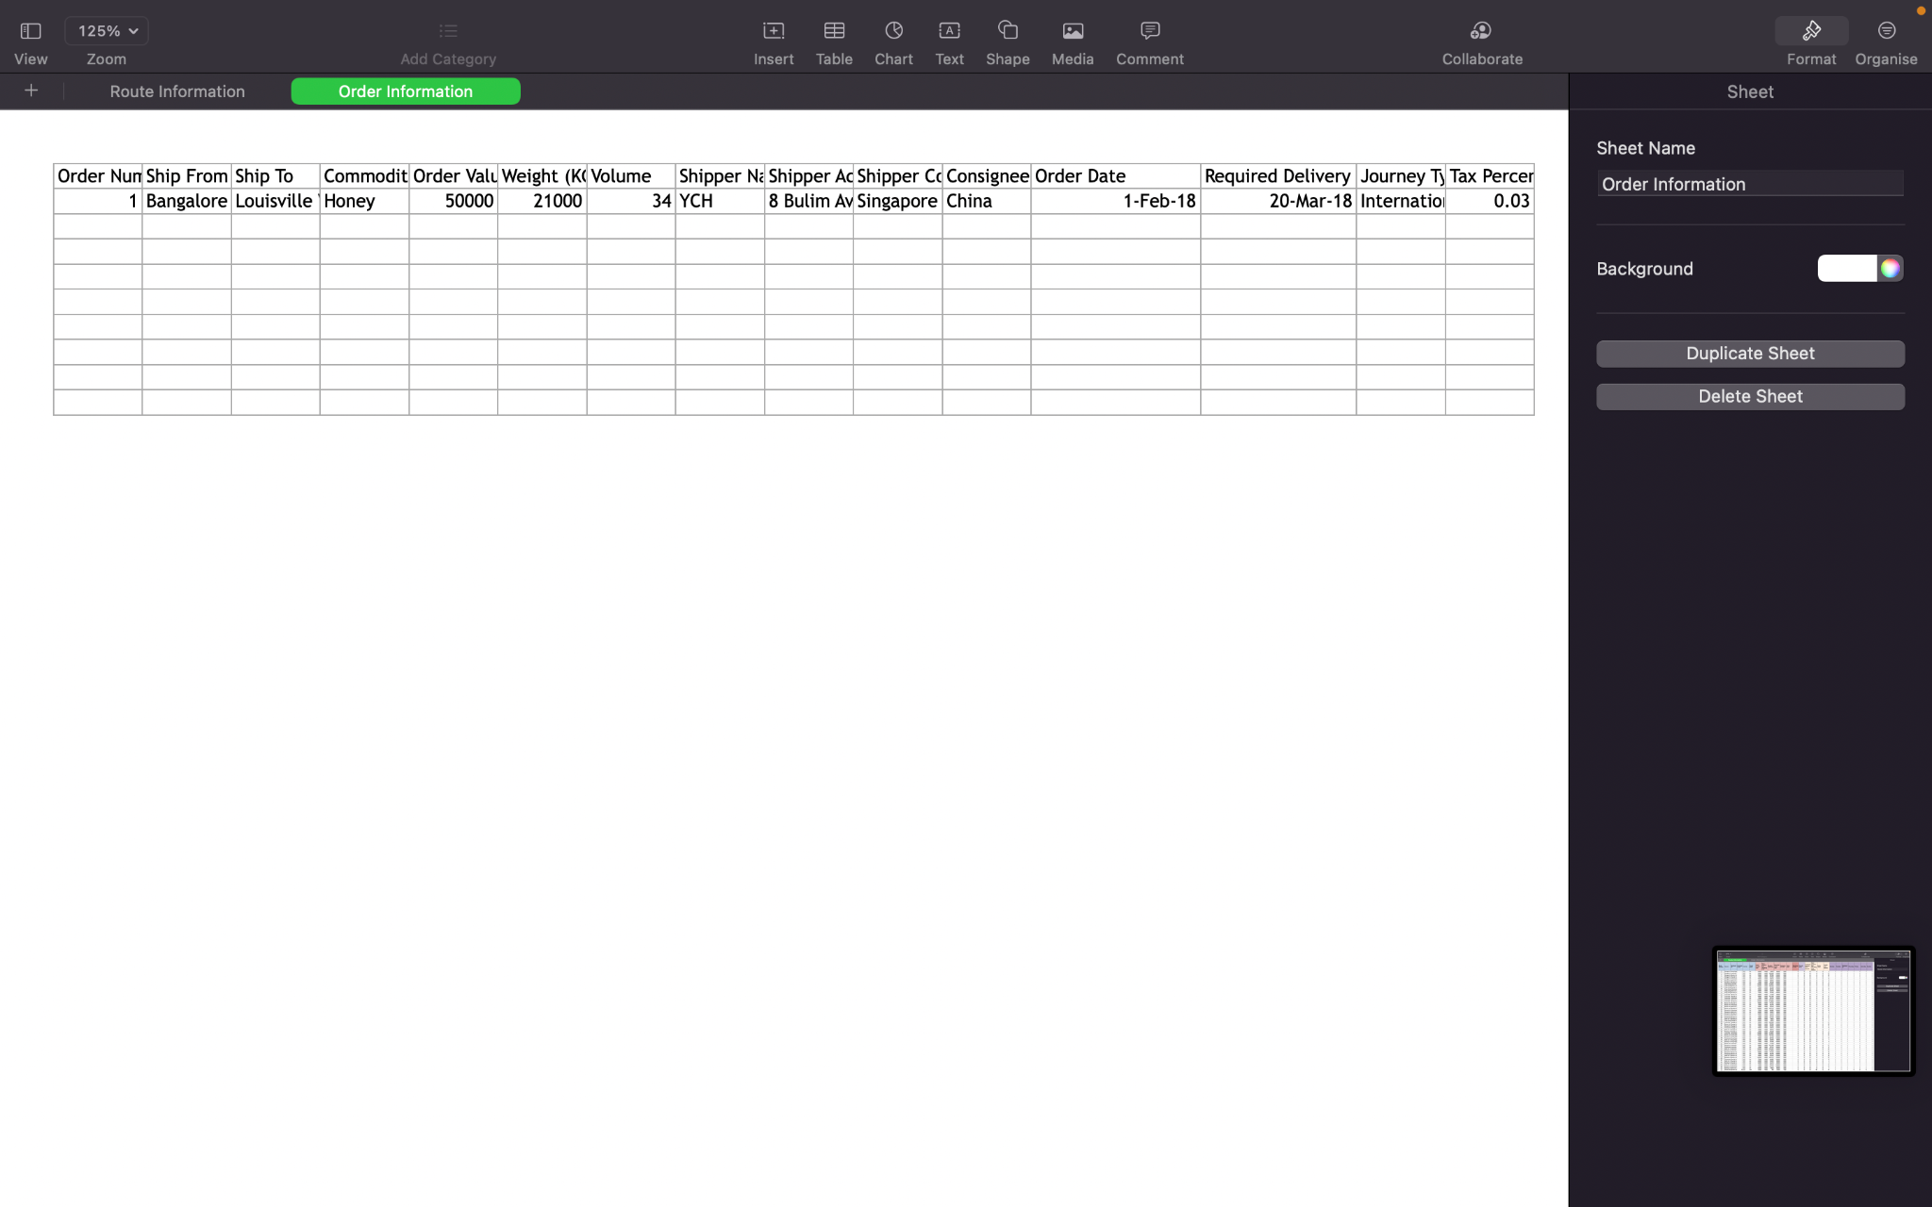
DATASET
ORDER INFORMATION

Slide 9
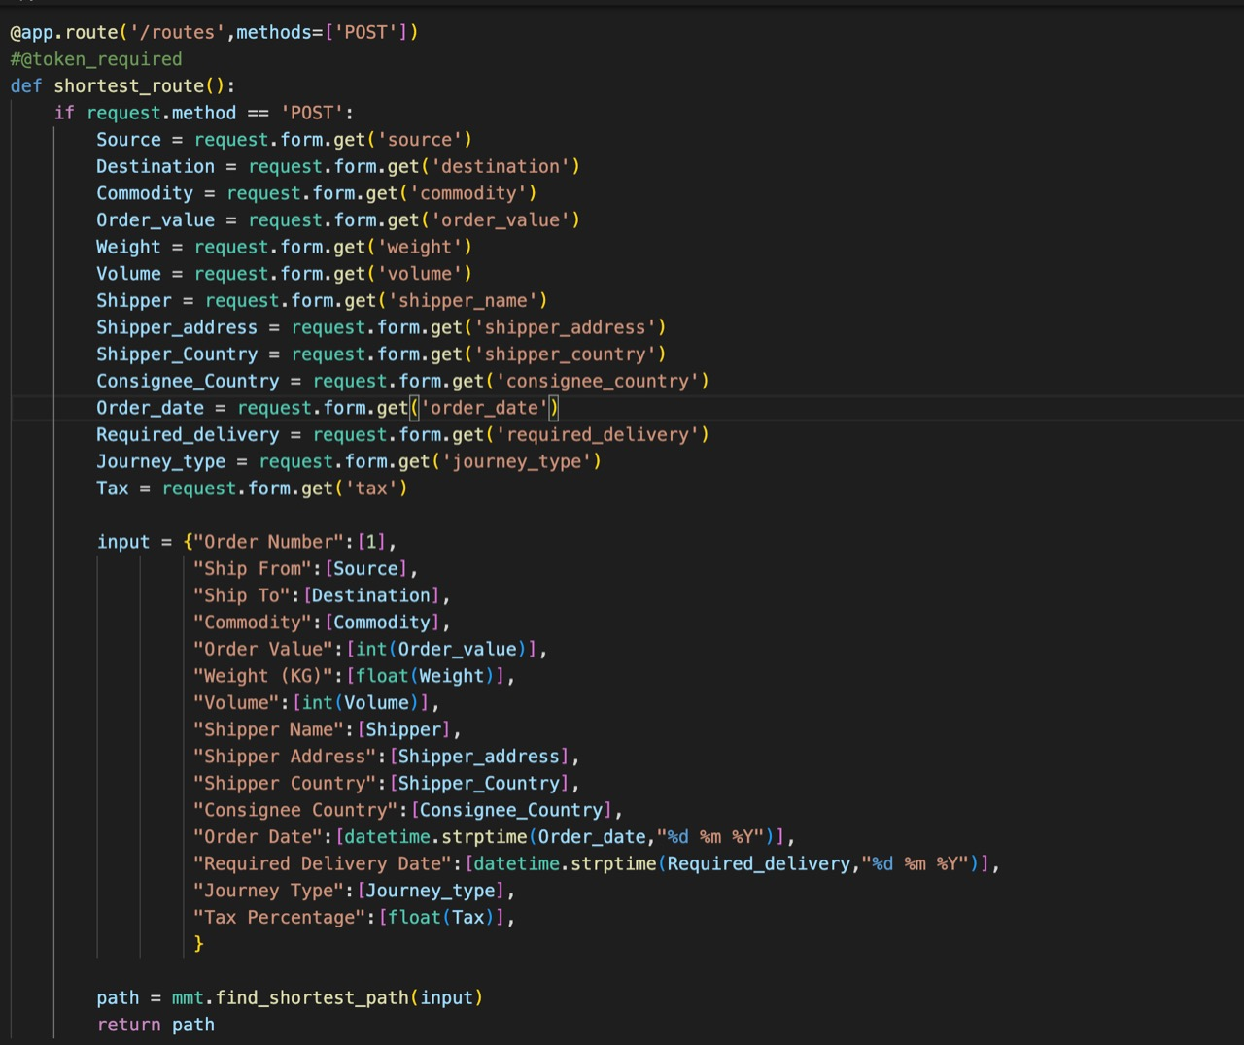
CURRENT PROGRESS
REST API

Slide 10
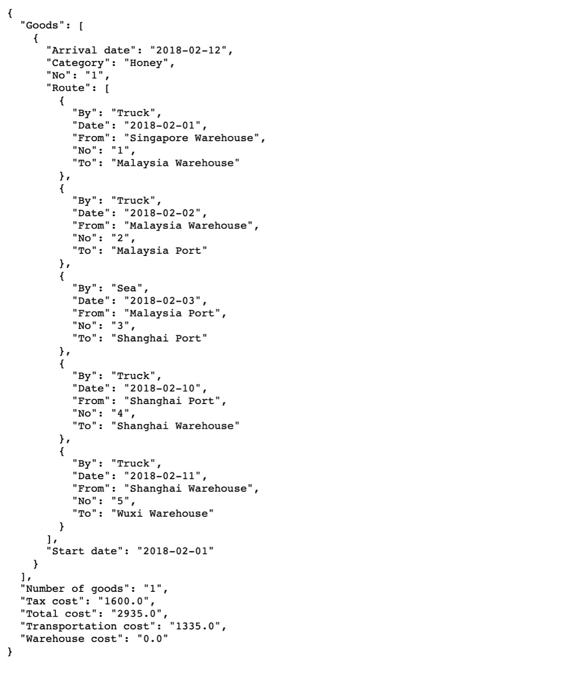
CURRENT PROGRESS
REST API

Slide 11
FEATURES TO BE ADDED
DYNAMIC SCHEDULING
Extending single path to multiple paths
Tracking of various logistics in transit
Priority based on reverse logistics to optimize scheduling

Slide 12
FEATURES TO BE ADDED
RECORD KEEPER/RECORD LEDGER
Keep track of reverse logistics data
Using ledgers instead of traditional DB to maximise security
Used for drawing insights for future scheduling

Slide 13



TECHNOLOGIES USED
FLASK
BACKEND
FLUTTER
FRONTEND
GOOGLE API
DYNAMIC MAPPING

